Slide 1
Electricity Demand Forecasting
STAT-S 650
Spring 2024
Dhairya Jayesh Chheda
M.S. Data Science (Residential)
dhchhed@iu.edu

Slide 2
Introduction
Time Series data are collected based on certain periods which have constant values (e.g., daily, weekly, or monthly).
Prediction is one of the objectives of the time series analysis by identifying the model from previous data and assuming the current information will also occur in the future.
The system cannot function without accurate forecasts. This is because electricity cannot be stored in large quantities.
The demand must be covered on an ongoing basis with production, with the limitations resulting from the flexibility of the production units and the requirements of the reliability and safety of the system operation.
The accuracy of forecasts translates into the costs of production, transmission, and the degree of reliability of electricity supply to consumers.
Inflated forecasts lead to the maintenance of too many generating units in order to meet the safety requirements to ensure an adequate margin of reserve capacity. Underestimated forecasts have the opposite effect—too few generating units are planned, which are not able to cover the actual demand.
Electricity demand forecasting is an essential tool for energy management, maintenance scheduling and investment decisions in the energy markets.
Electricity demand for a region depends on economic variables – oil prices, stock prices, exchange rates; demographic circumstances – holidays, population and most importantly climatic conditions – temperatures, humidity etc.
In this project we want to measure how daily temperatures affect electricity demand for a region.
We will also investigate how accurately temperature can be used to forecast the demand in mid-term (8 weeks/2 months).

Slide 3
Objective
Electricity demand forecasting is an essential tool for energy management, maintenance scheduling and investment decisions in the energy markets.
Electricity demand for a region depends on economic variables – oil prices, stock prices, exchange rates; demographic circumstances – holidays, population and most importantly climatic conditions – temperatures, humidity etc.
In this project we want to measure how daily temperatures affect electricity demand for a region. We will also investigate how accurately temperature can be used to forecast the demand in mid-term (8 weeks/2 months).
Data
The data is for operational electricity demand for Victoria, Australia. Operational demand is the demand met by local scheduled generating units, semi-scheduled generating units, and non-scheduled intermittent generating units of aggregate capacity larger than 30 MW, and by generation imports to the region.
The dataset covers 365 days between 1 January 2020 and 31 December 2020.
There are 2 measures –
Demand – Total electricity demand in GW for Victoria, Australia, every day during 2020.
Temperature – Maximum daily temperatures during the day for Victoria, Australia
The data has 365 timepoints for each day in the year 2020.
‘Demand’ is the criterion of interest and ‘Temperature’ is the predictor variable.

Slide 4
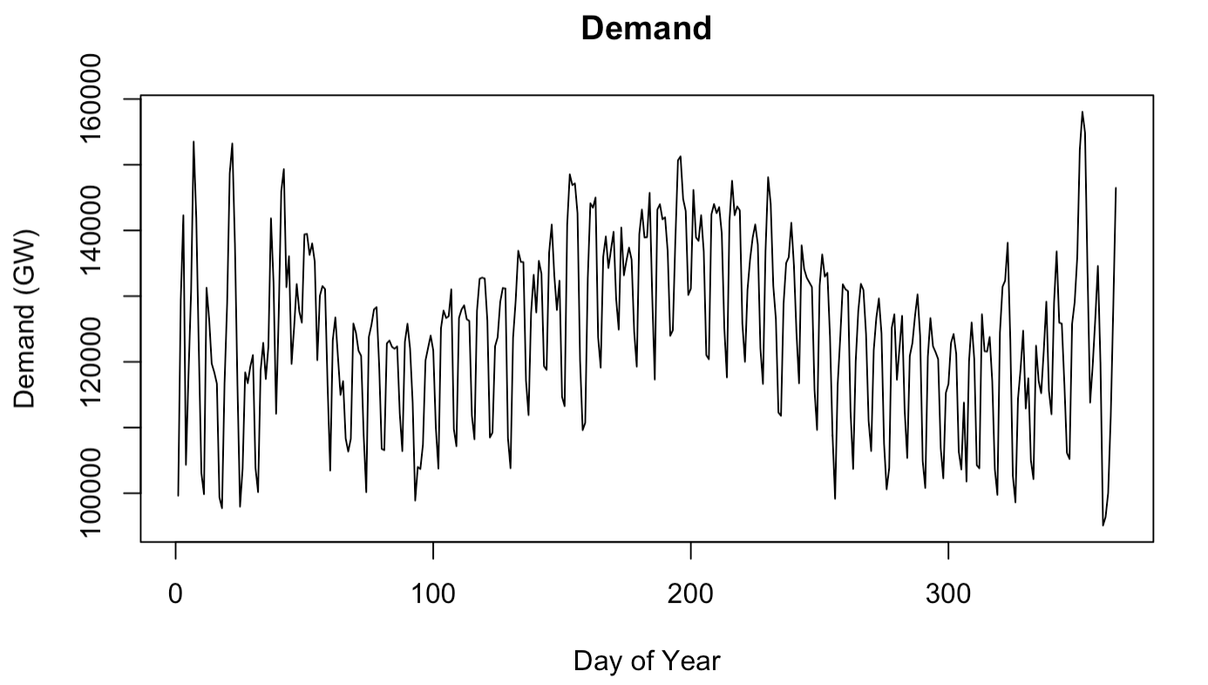
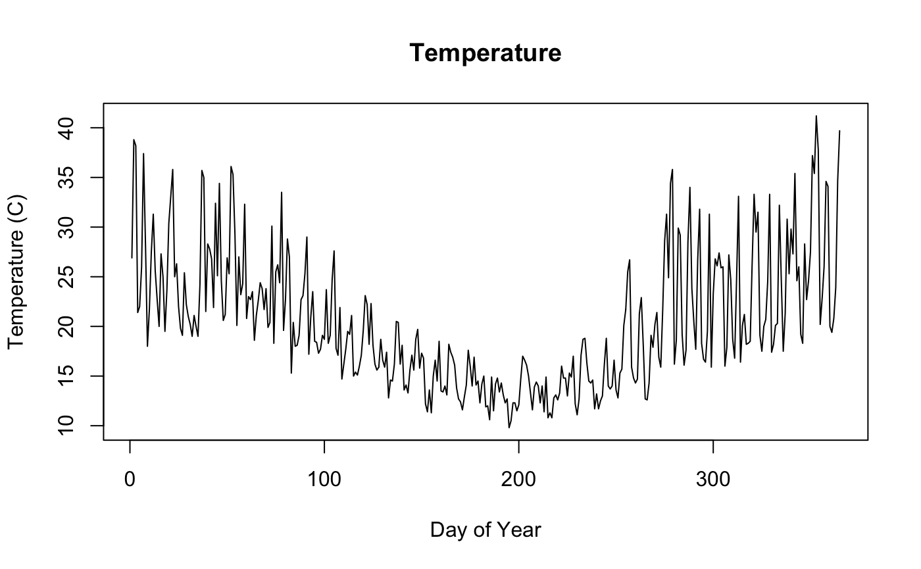
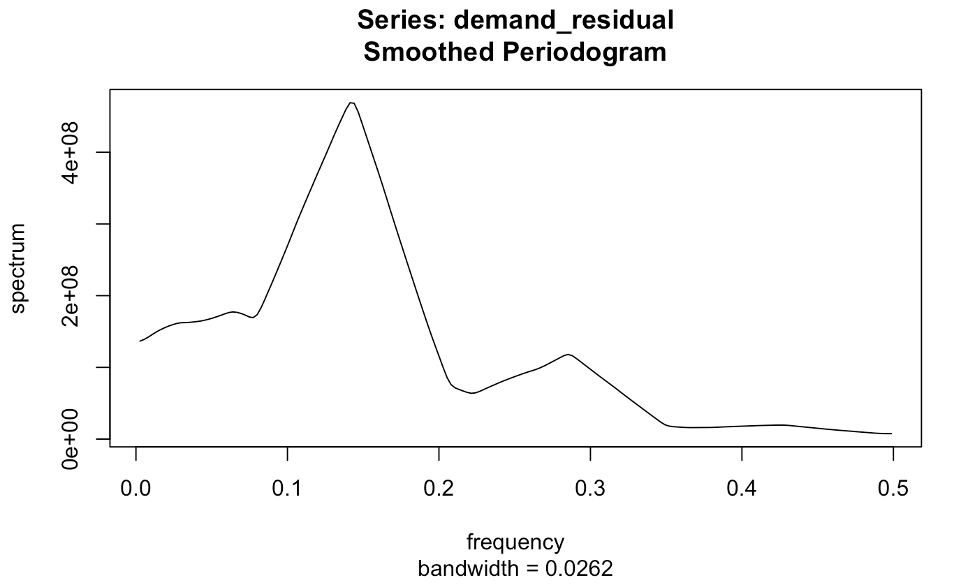
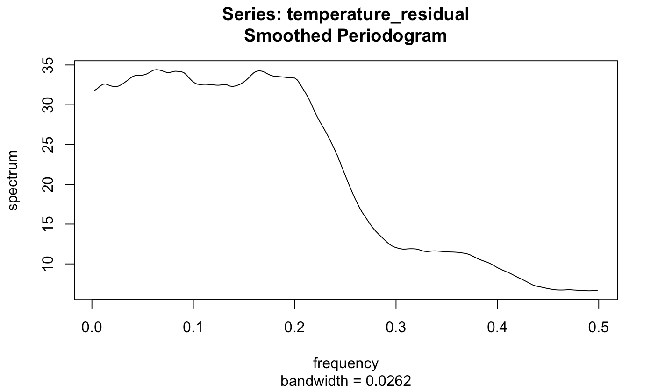
Data Analysis – Time Domain and Frequency Domain
Both series in figure 1 have a quadratic trend with cyclic components. We can therefore de-trend both series using regression and then investigate the noise (residuals) using auto-correlation and spectral analysis.
Fig. 1 – Daily Demand and Max Temperatures for 365 days in 2020
From figure 2, we can see that both ‘Demand’ and ‘Temperature’ have systematic cycles.
For Demand, we have spikes at f₁ = .1428571 and f₂ = .2857143 denoting some periodicity every 7 days and 3.5 days, respectively.
For Temperature, we have a small spike at f₃ = .1706667 denoting some periodicity every 6 days.
So, we will try to remove these using regression by fitting sinusoids at these frequencies.
Fig. 2 - Periodogram for each measure

Slide 5
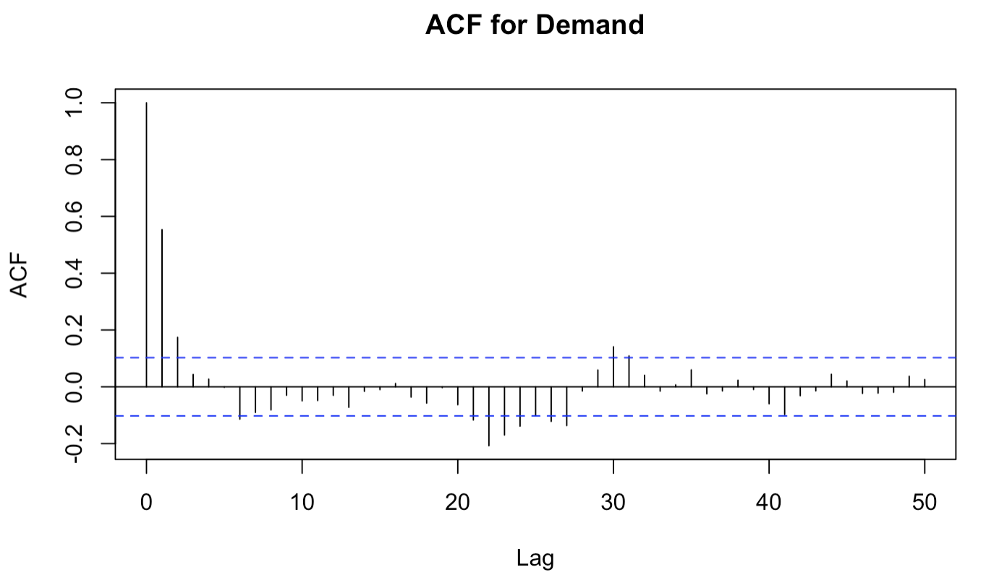
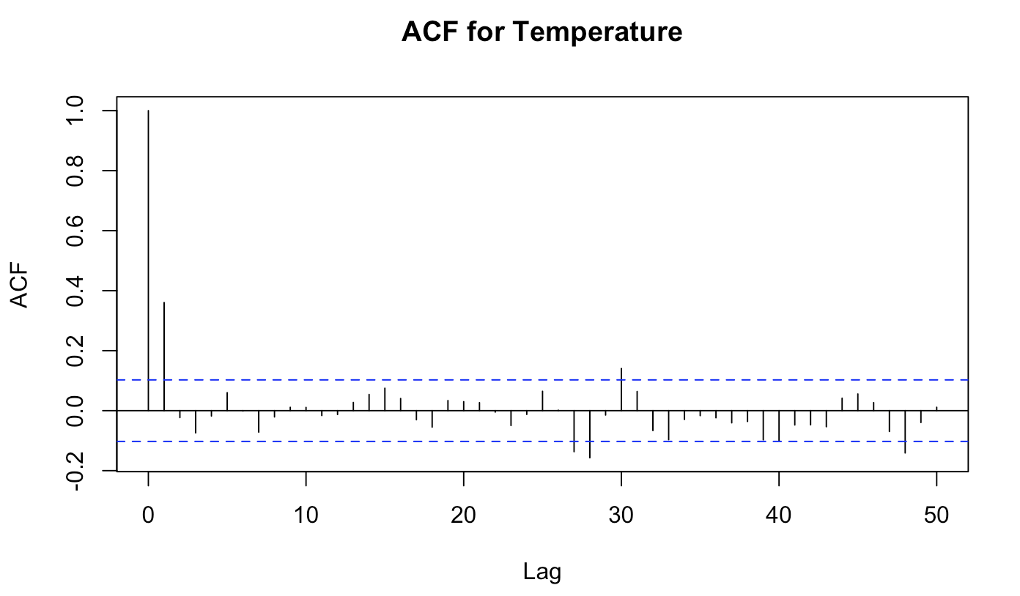
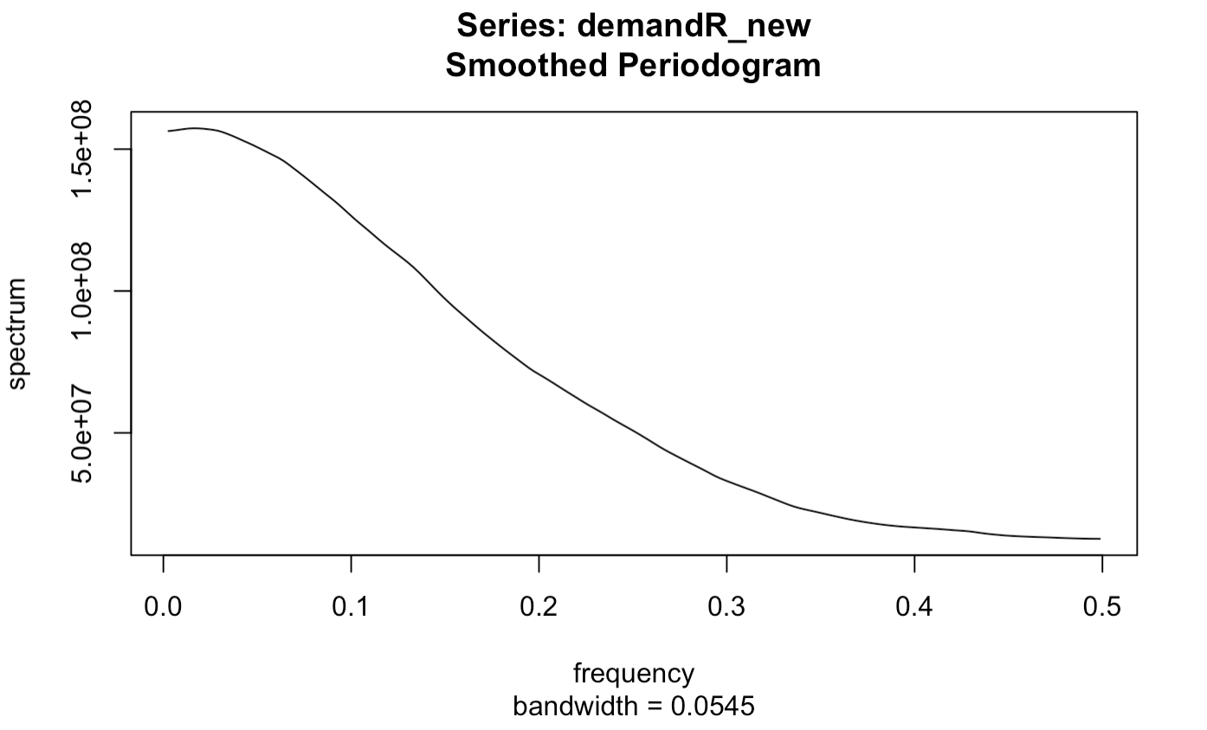
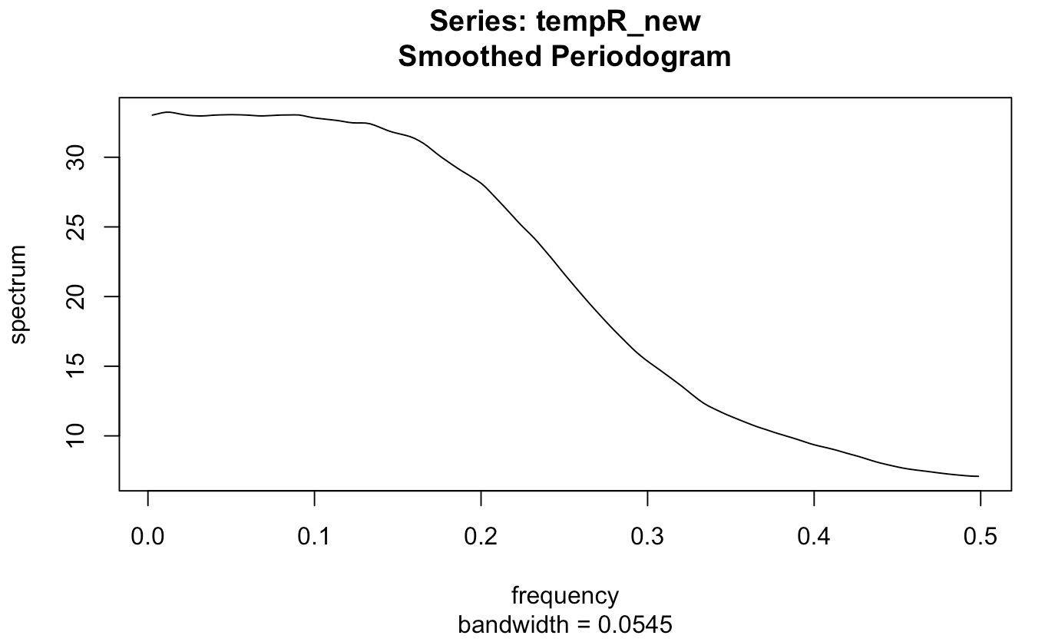
Data Analysis – Auto-correlation and Spectral Density
To make both series stationary, we used order 6 and 4 polynomials to de-trend demand and temperature, respectively. Further, we used sinusoids to remove the systematic cycles.
Upon looking at the auto-correlation plot for Demand, it looks like it is an AR process.
Upon looking at the auto-correlation plot for Temperature, it looks like it is an MA process.
Fig. 3 – Auto-correlation of residuals for each measure after de-trending using regression
Although spectral density for Demand has a cosine shape, we saw above that it is an AR process. Since it is a combination / mixture of both, we can say that Demand is probably an ARMA process.
The spectral density for Temperature has a cosine shape, which means it is an MA processes.
Fig. 4 – Spectral Density of residuals for each measure

Slide 6
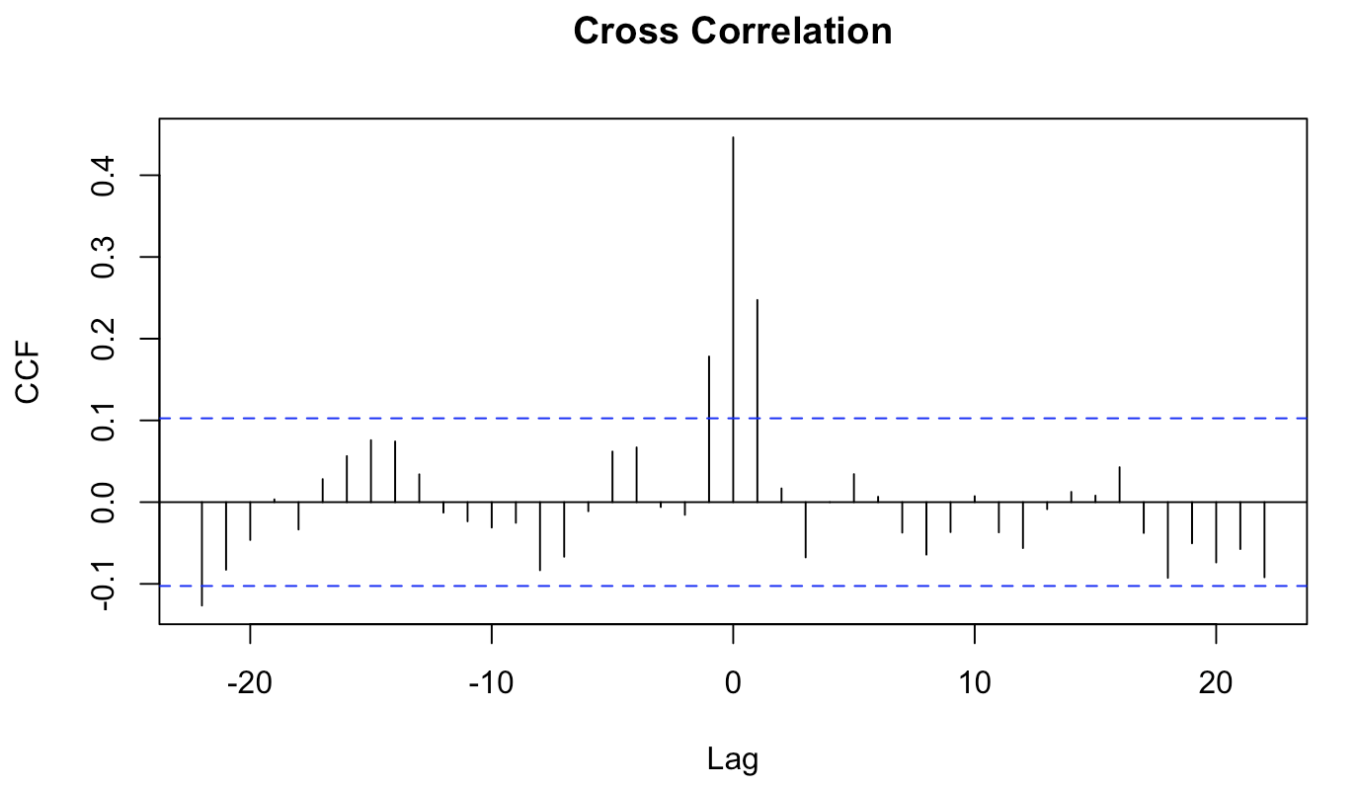
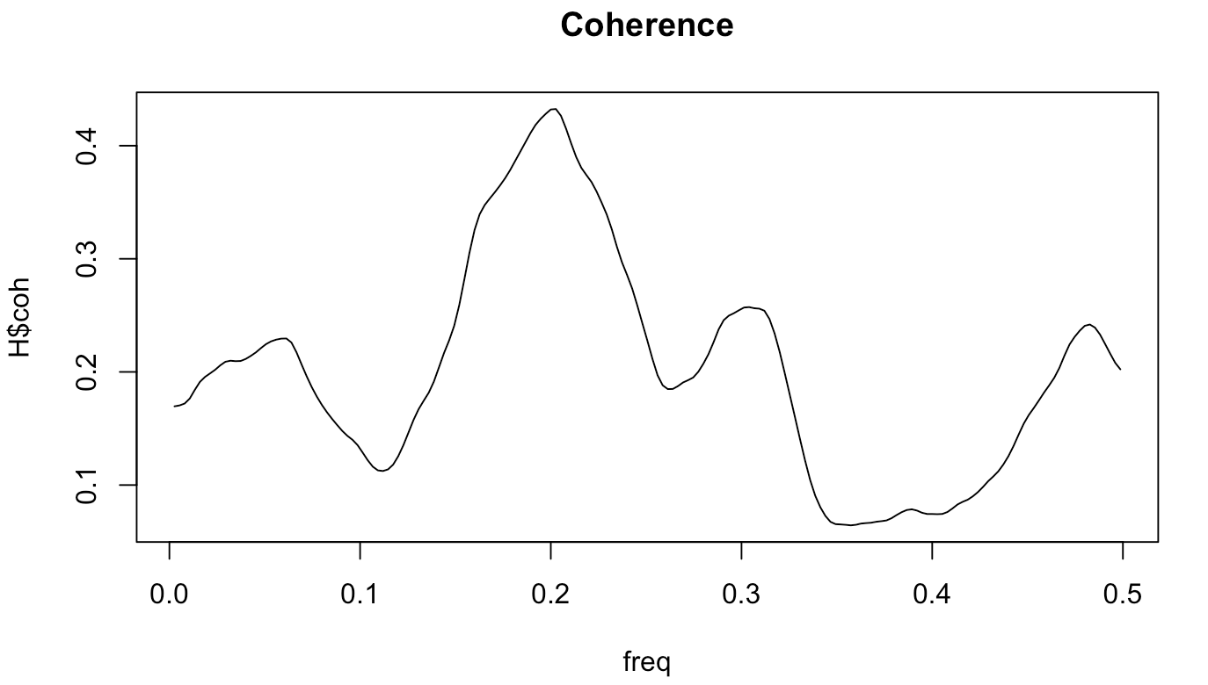
Data Analysis – Cross-correlation and Coherence
From the cross-correlation plot, we can say that both series are leading each other at lag of 1. The plot shows that for most lags, the correlations are within the confidence bounds (indicated by the blue dashed lines) suggesting that there are no significant correlations at those lags. The peak of the cross-correlation plot is at a positive lag, suggesting that the demand is anticipating the temperature.
Moreover, from the spectral density coherence plot, there are peaks, suggesting the presence of multiple periodic components in the data. The values in the coherence plot fluctuate more than in the squared coherence plot and reach higher peaks. This is the typical appearance of a coherence function. There appear to be peaks around 0.05, 0.2, 0.33 and just before 0.5 frequencies, which suggests that there is some degree of correlation between the two signals at these frequencies, although the correlation is not that high.
Fig. 5 – Cross-correlation and cross-spectral analysis for each measure after de-trending using regression

Slide 7
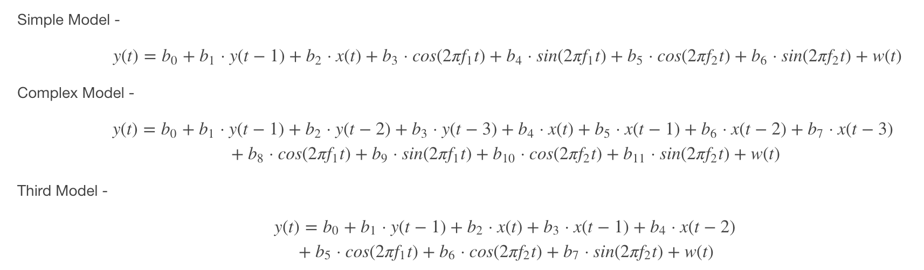
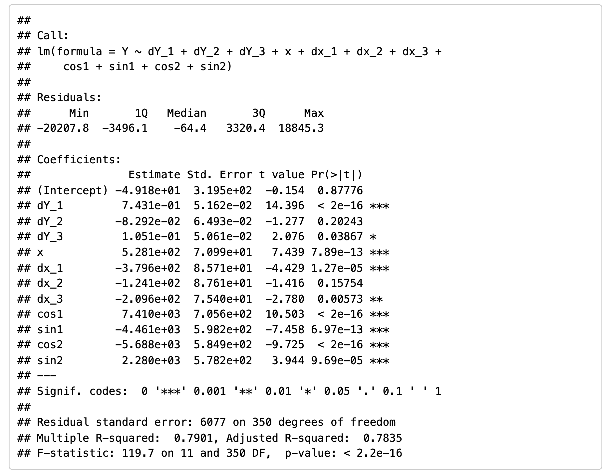
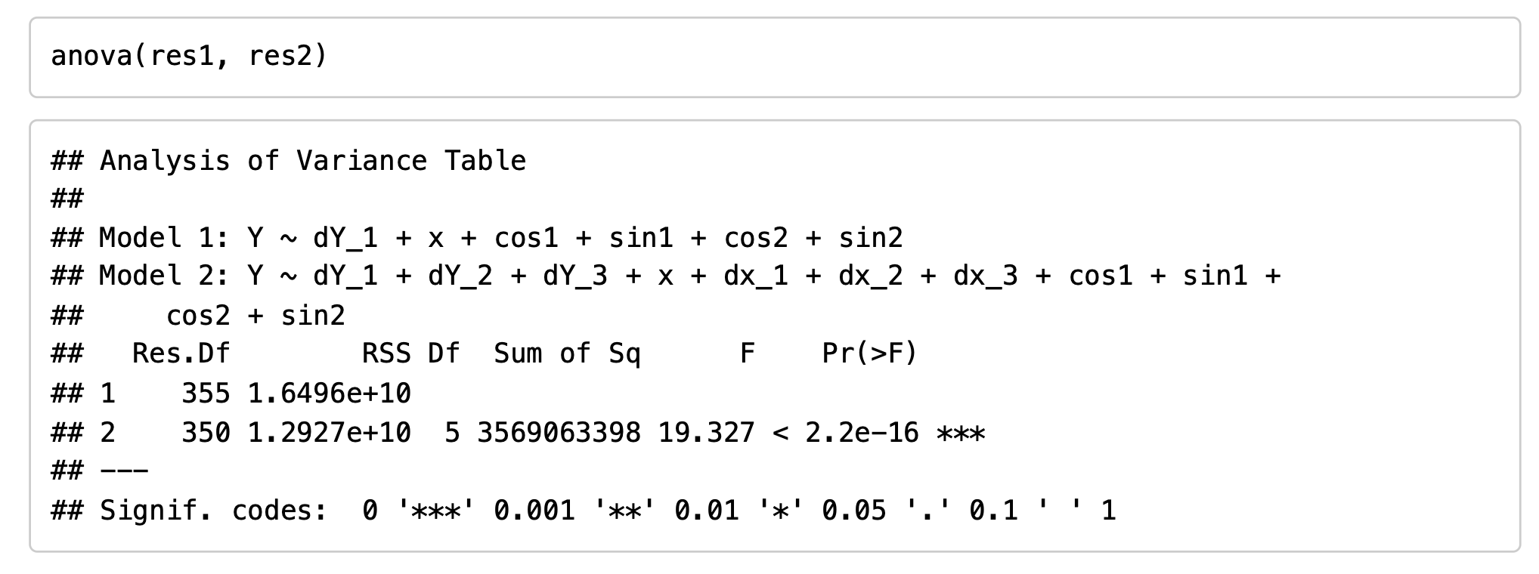
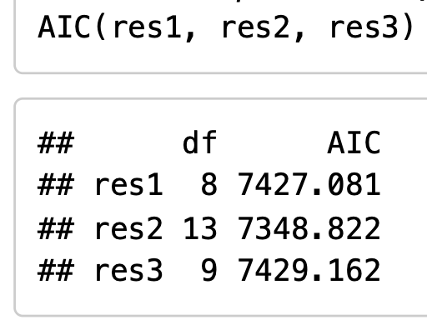
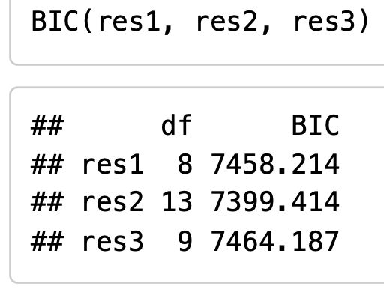
Model Estimation and Comparison – Linear Difference Equation with white noise
Here we have 3 competing difference equation models. The simple model is nested within the complex model and the third model is not nested. y(t) is the criterion, i.e., 'Demand' and x(t) is the predictor, i.e., 'Temperature'.
w(t) is white noise.
f₁, f₂ are frequencies where y(t) shows systematic cycles in the periodogram.
By looking at the F-test, we see that we get a p-value < 0.01 significance level, which means we can reject the Null Hypothesis (H₀) and accept the Alternate Hypothesis (H₁), i.e., both models (simple vs. complex) are not same.
By looking at the AIC and BIC metric, we can see that the Complex Model with an adjusted R² = 0.7835 is best as it has the lowest AIC and BIC scores.

Slide 8
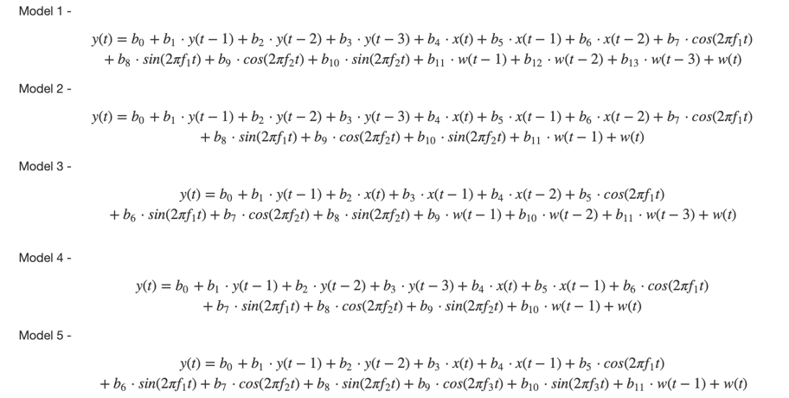
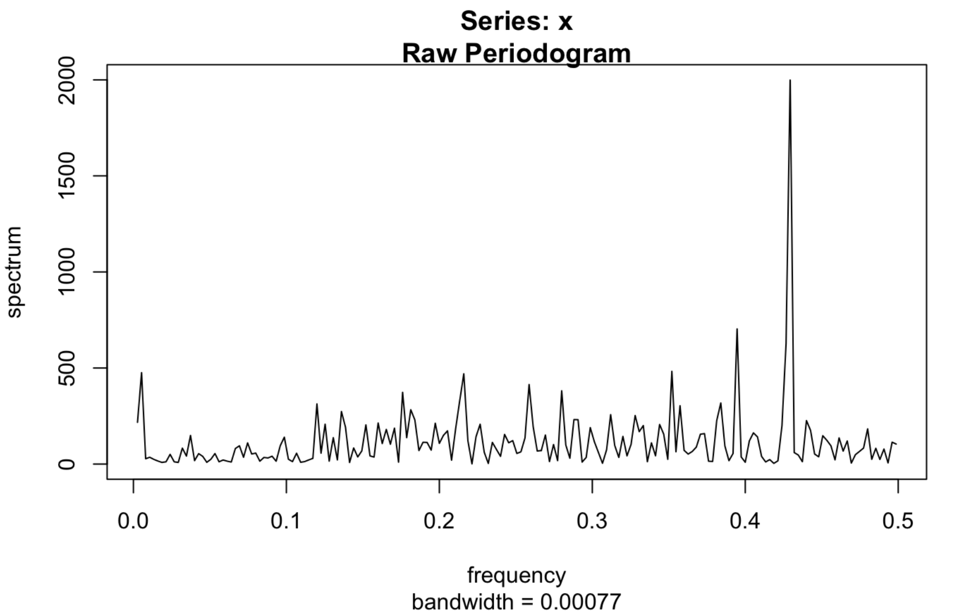
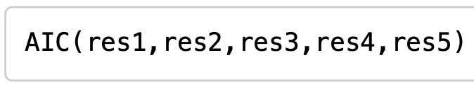
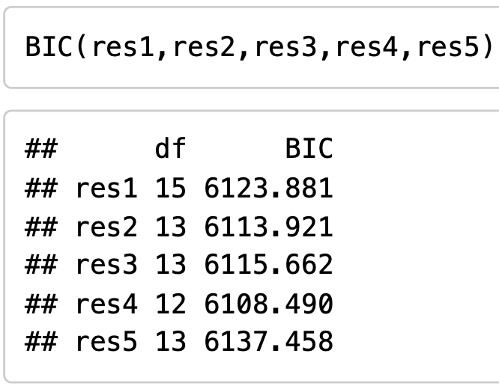
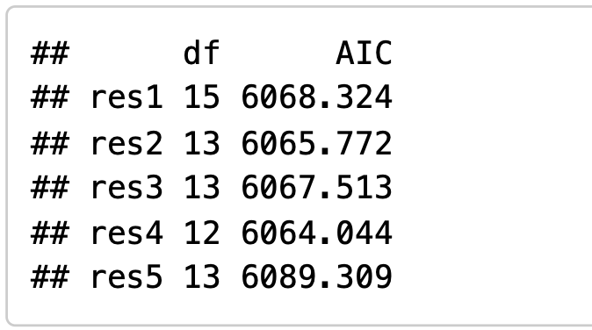
Model Estimation and Comparison – ARMAX
Fig. 5 – Spectral Analysis on the residuals from
Here we have 5 competing ARMAX models of varying complexity in terms of autoregressive and moving average components.
y(t) is the criterion, i.e., Demand and x(t) is the predictor, i.e., Temperature.
w(t) is white noise.
f₁, f₂ are frequencies where y(t) shows systematic cycles in the periodogram.
When we look at the periodogram of the residuals from the previous best model i.e., Complex Model, we saw there was a spike around f₃ = .429333333 , so we added sinusoids at f₃ to take care of this in our ARMAX models.
Since the models are not nested, we can use AIC and BIC to compare and choose the best model. We can see Model 4 has the lowest AIC and BIC scores, and therefore is our champion model.

Slide 9
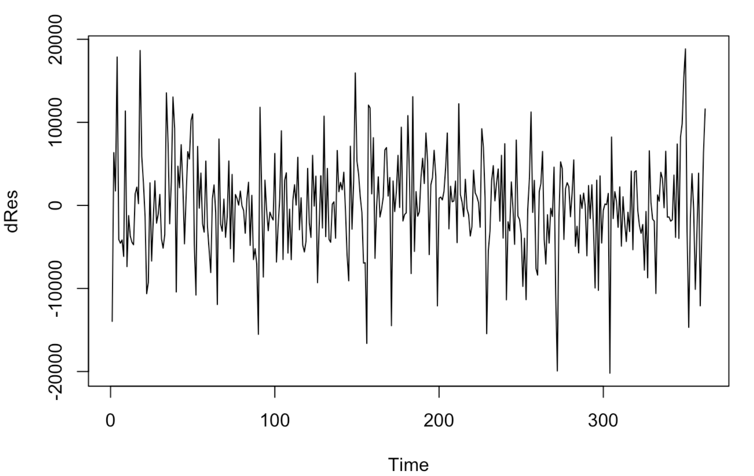
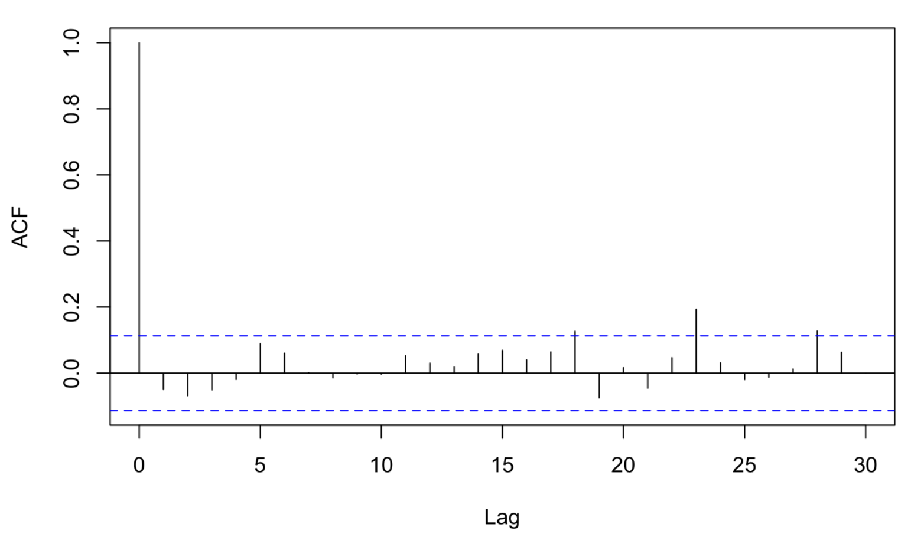
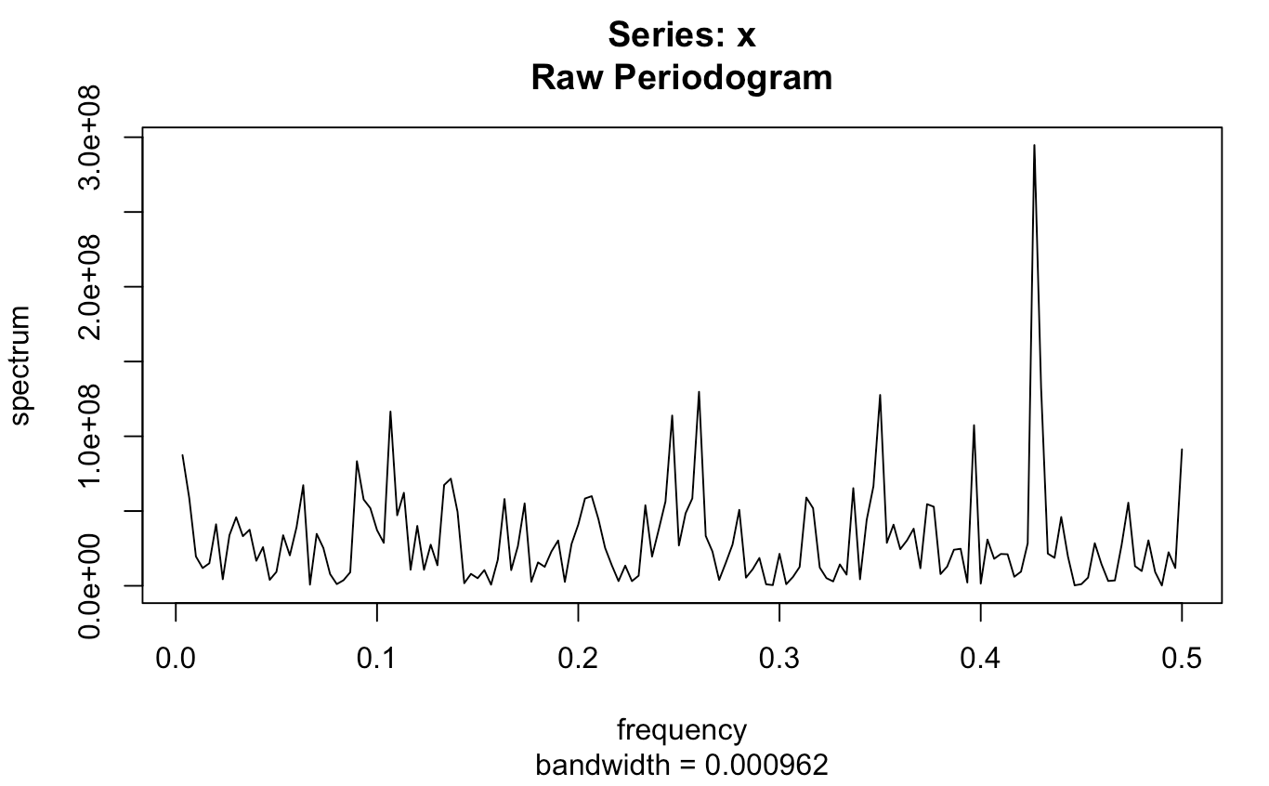
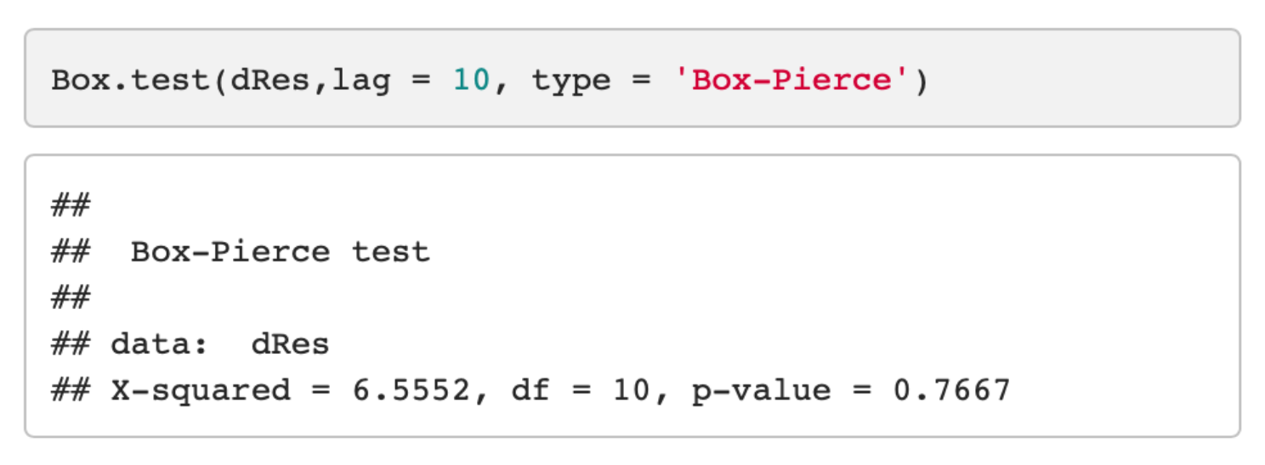
Residual Analysis – Champion Model
We observe the residuals are centered around zero and variance looks constant. The auto-correlation plot also does not show correlation at different lag components.
Fig. 7 – Variance and Auto-correlation of residuals after fitting the champion model
From Box-Pierce test, we can say that there is no significant evidence of auto-correlation up to lag 10 components. The periodogram looks flat with no significant peaks suggesting no auto-covariance at different frequencies. Thus, the residuals are white noise.
Fig. 8 – Result of Box-Pierce test and Spectral Analysis on the residuals

Slide 10
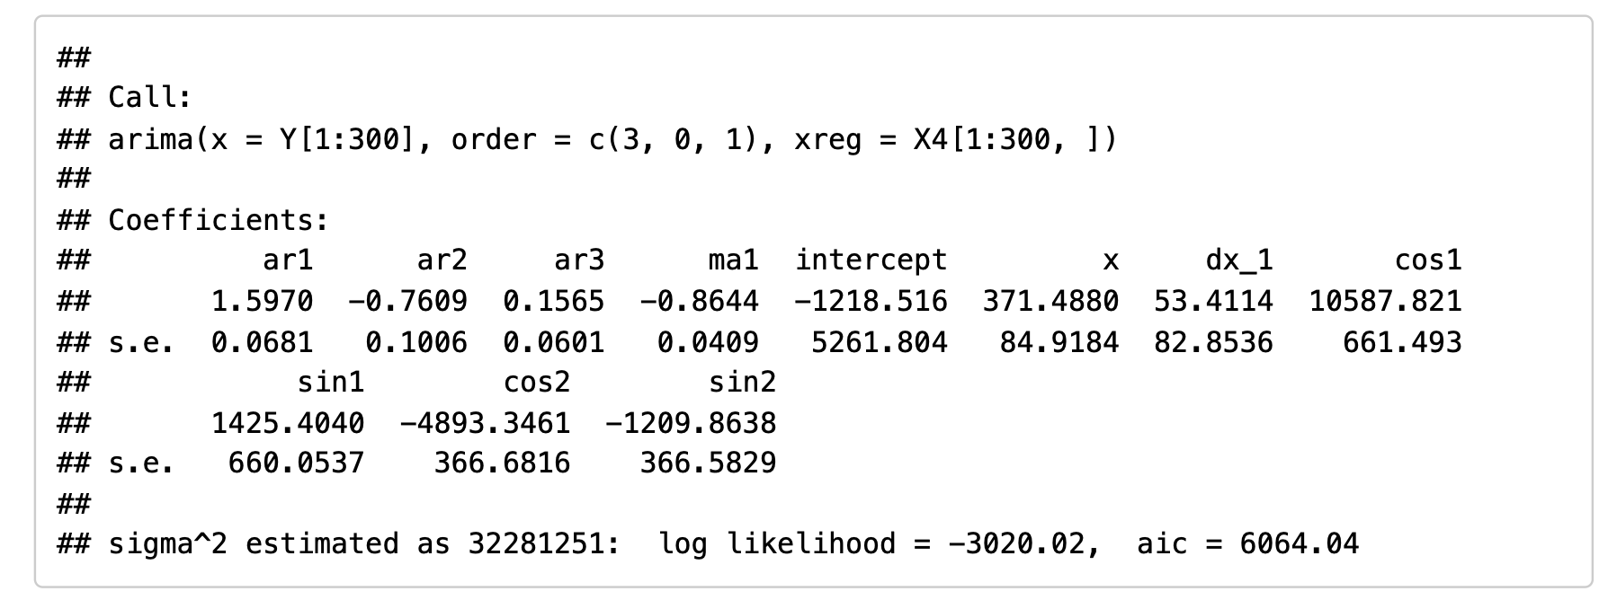
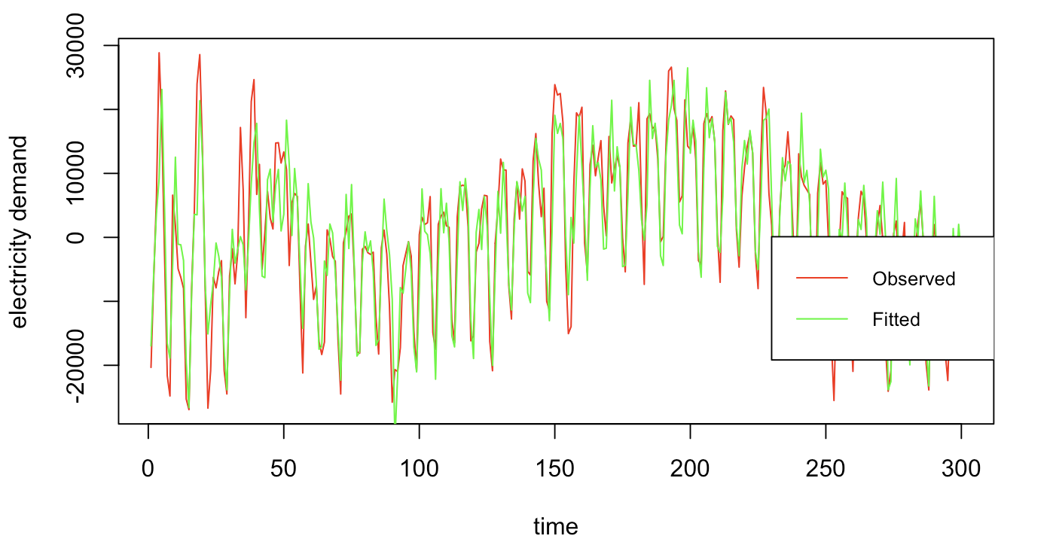
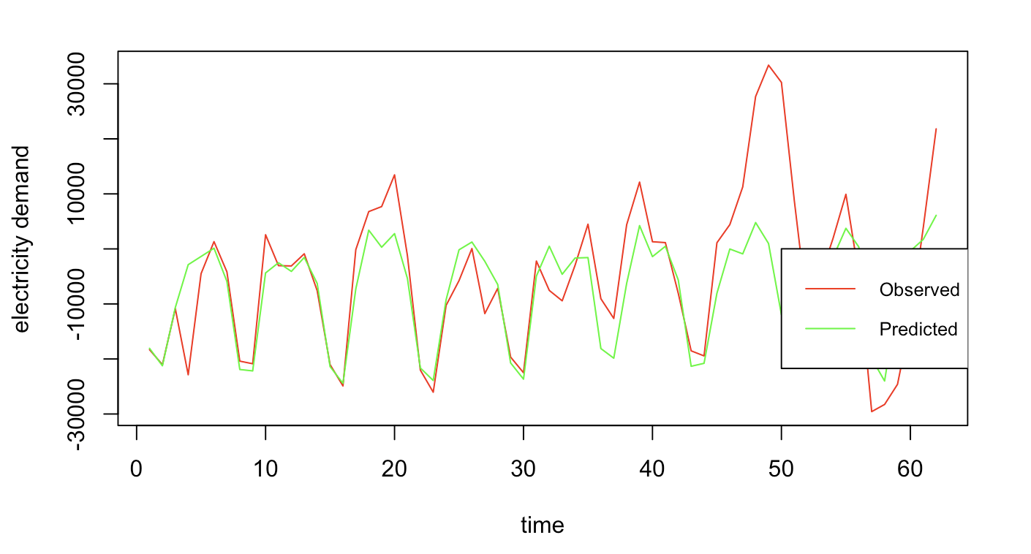
Interpretation and Forecast – Champion Model
The model includes 3 autoregressive terms and 1 moving average term. The AR(1) term seems to be significant and large relative to its standard error, suggesting a potentially strong influence on the model. The AR(2) term is significant but negative, while the MA(1) term is also significant and negative. The exogenous variable x included in the model is positively correlated with the dependent variable, implying that as x increases, so does the output. The sinusoids cos1 and sin1 are included to capture cyclic or seasonal trends. Since the coefficients are positive it means there is a positive correlation between temperature and electricity demand.
Fig. 9 – Coefficient and Std. Errors of estimates for the champion model
We can see the model estimates the observed data very closely. The model captures the peaks very accurately but is over-estimating the troughs.
Since our goal was to see how well the model can be used for forecasting, we used the first 300 datapoints for estimating the model parameters and latter 65 datapoints ~ 8 weeks/2 months for forecasting. We can see the model estimates the observed data very closely.
Fig. 10 – On the left, we have the observed data and fitted values from the champion model. On the right, we have the observed and predicted values on hold out data.

Slide 11
Conclusion
We see the model does a pretty good job in predicting the future values of demand for the first few cycles. The performance degrades for future time points which is expected since ARIMA works for short / mid-term and not long-term predictions.
In conclusion, we can infer that daily temperatures works well in estimating the electricity demand over time.
Since our data was for one year, we were restricted by number of predictors which could be taken into consideration. If data is available for more time points, it would be interesting to see how the other factors like humidity and holidays affect the demand.
Acknowledgement
The author wishes to thank Prof. Jerome R. Busemeyer for his guidance and support. This work was part of the Time Series Analysis (STAT-S 650) course for Spring 2024 at Indiana University, Bloomington.
Thank you!

